Slide 1
Geometric Transformation

Slide 2
Image Interpolation
Interpolation in image processing is a technique used to estimate pixel values at non-sampled points based on known pixel values. It is essential in various applications, such as resizing images, enhancing image quality, and remapping pixel grids. Common methods of interpolation include:

Slide 3
Nearest Neighbour: Assigns the value of the nearest known pixel to the unknown pixel.
Bilinear: Applies linear interpolation in two dimensions, considering the closest four pixels.
Bicubic: Uses the values of the nearest 16 pixels to calculate the new pixel value, providing smoother results.
Interpolation is crucial in digital photos, especially during processes like Bayer demosaicing and photo enlargement. For a more detailed understanding, you can refer to the foundational concepts of image interpolation.

Slide 4
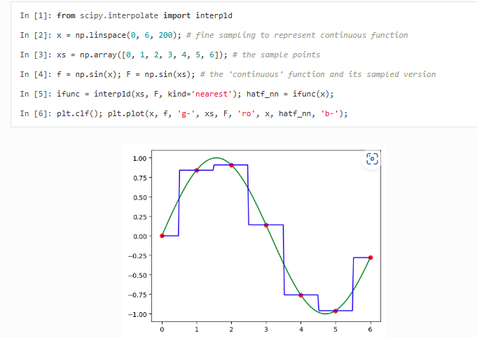
Nearest Neighbour

Slide 5
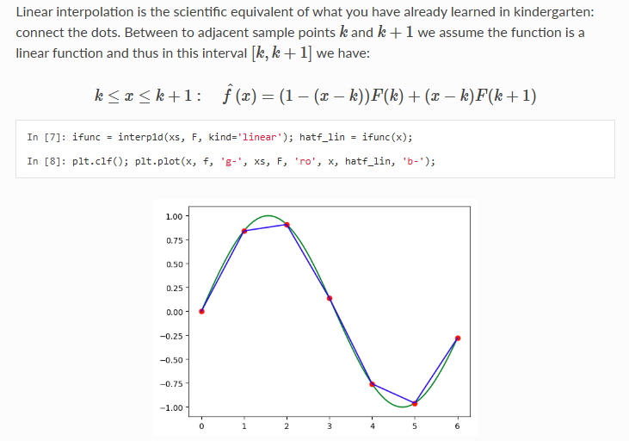
Linear Interpolation

Slide 6
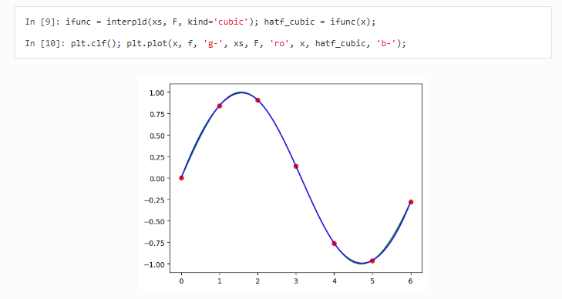
Cubic Interpolation

Slide 7
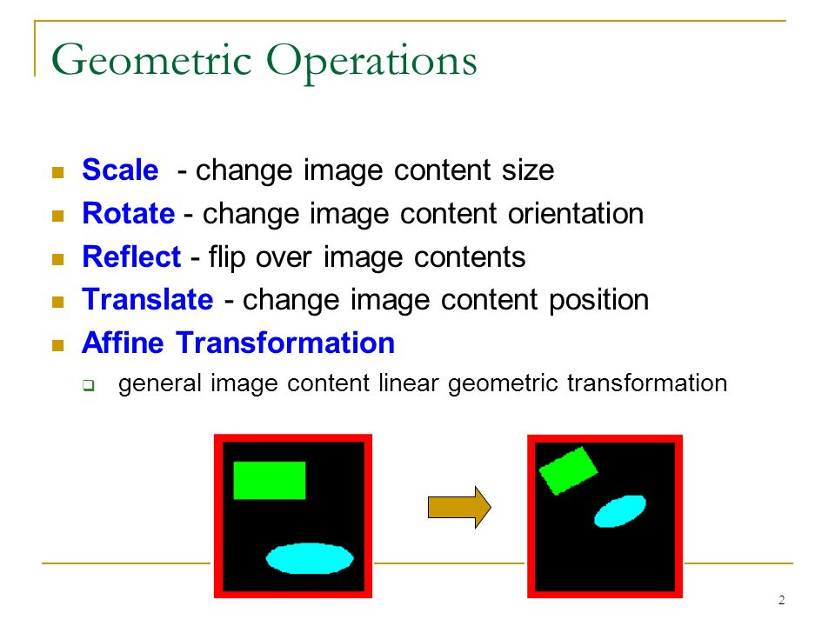

Slide 8
Translation:

Slide 9
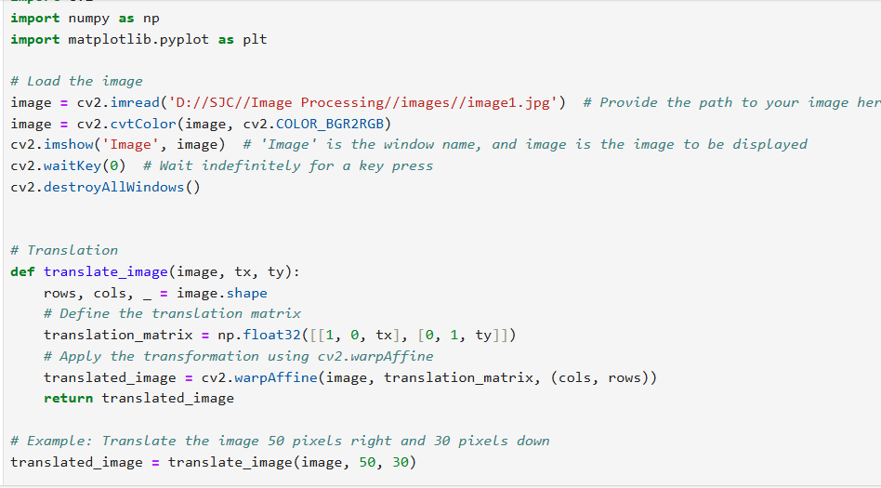

Slide 10
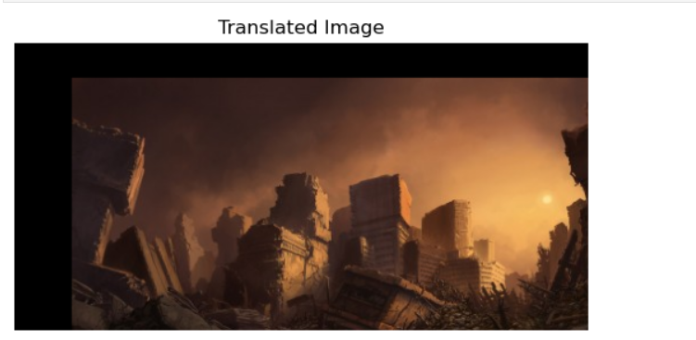

Slide 11
Rotation:

Slide 12
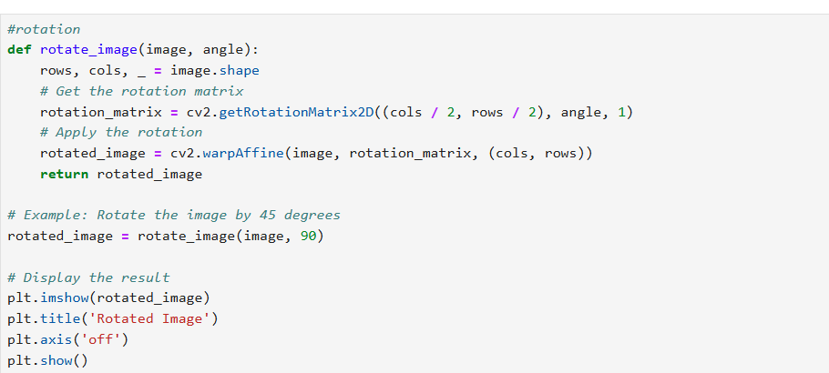

Slide 13
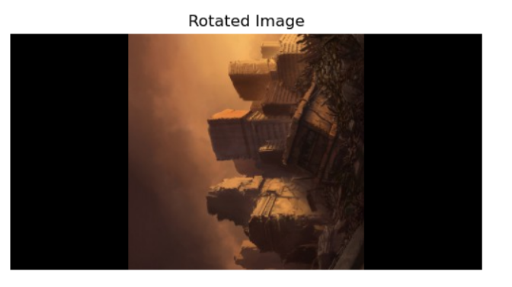

Slide 14
Scaling:

Slide 15
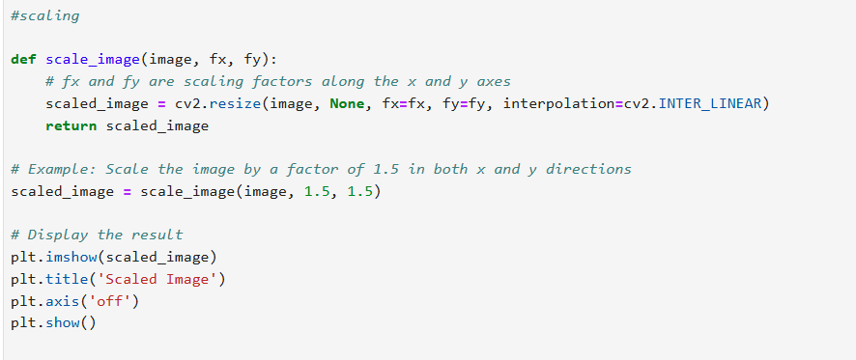

Slide 16
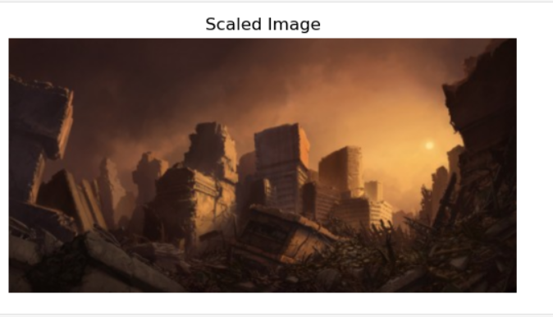

Slide 17
Affine transform:
An affine transformation is a type of geometric transformation which preserves collinearity (if a collection of points sits on a line before the transformation, they all sit on a line afterwards) and the ratios of distances between points on a line.

Slide 18
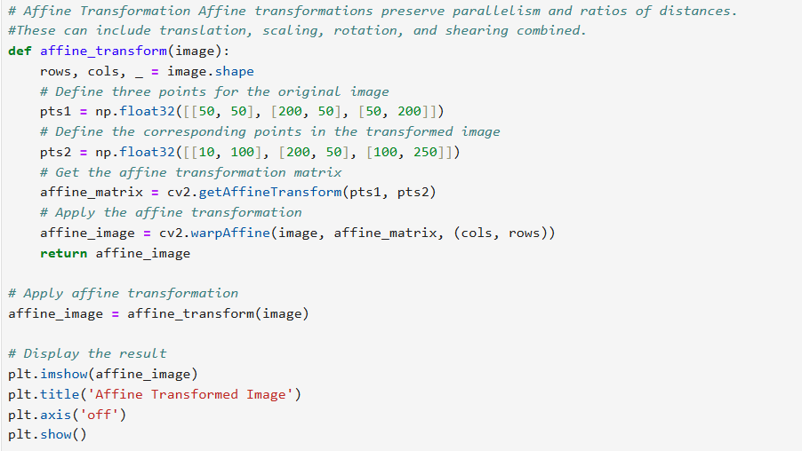

Slide 19
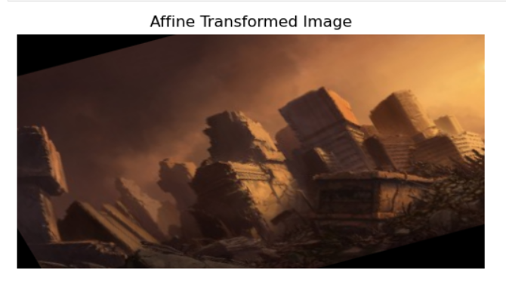

Slide 20
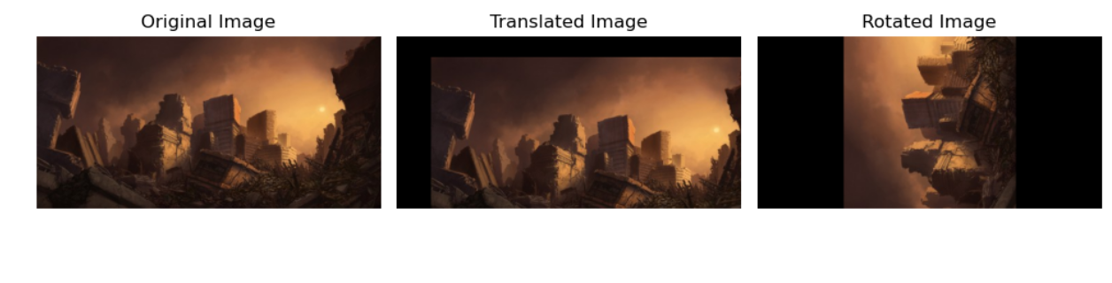
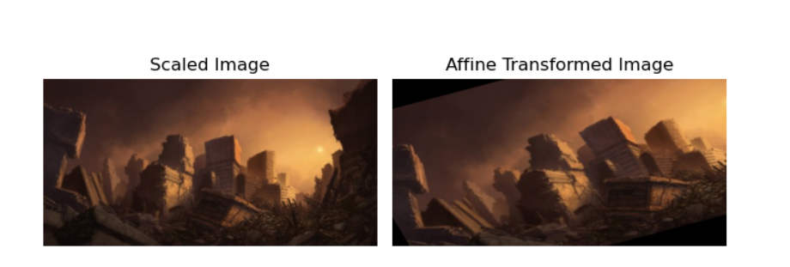

Slide 21
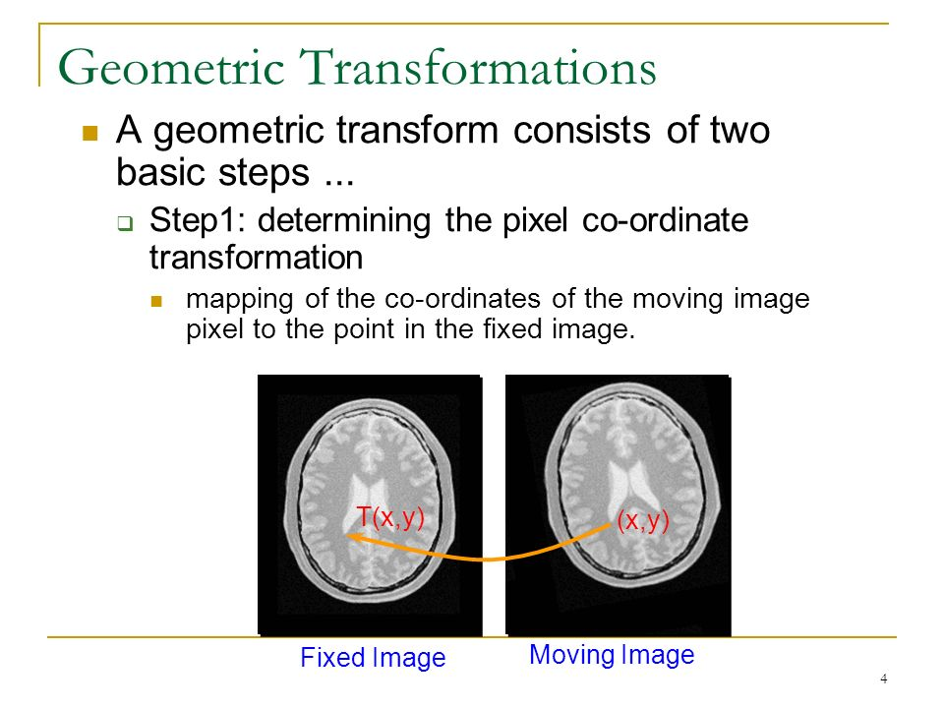

Slide 22
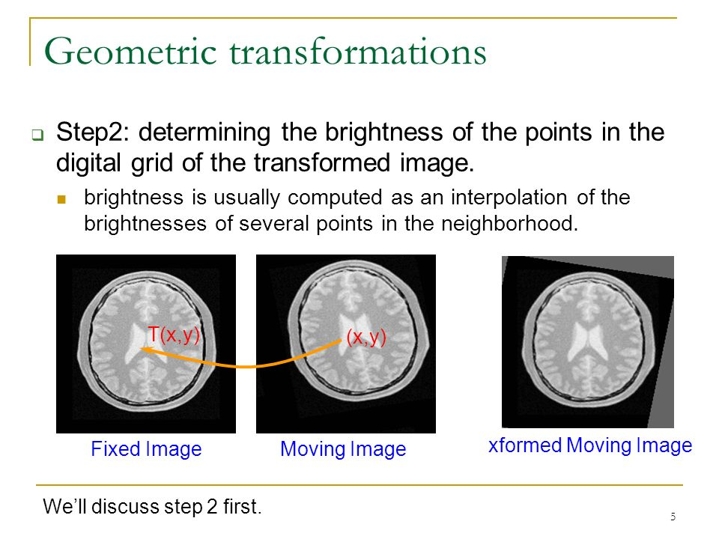

Slide 23
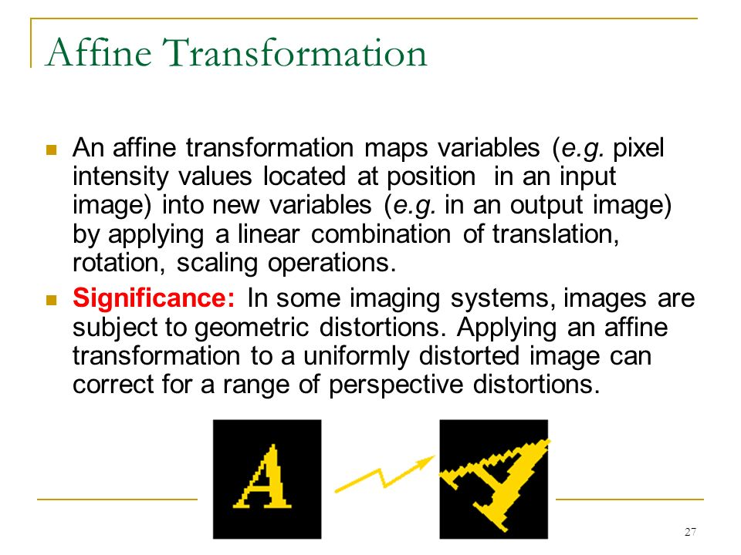

Slide 24
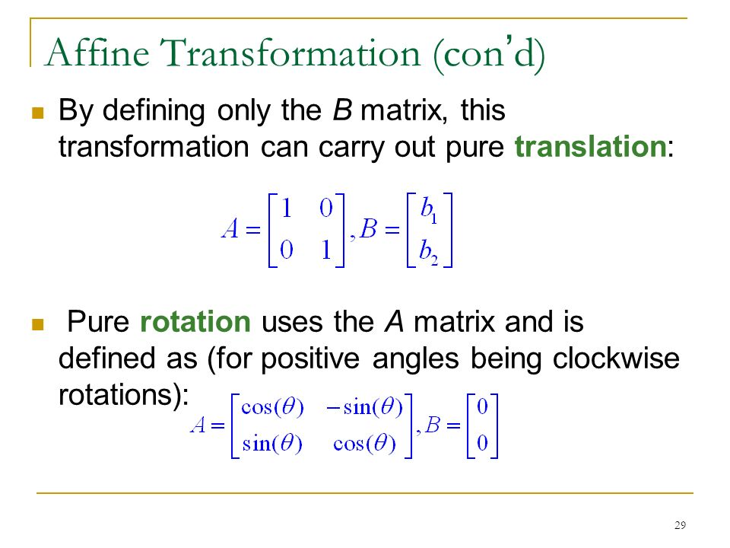

Slide 25
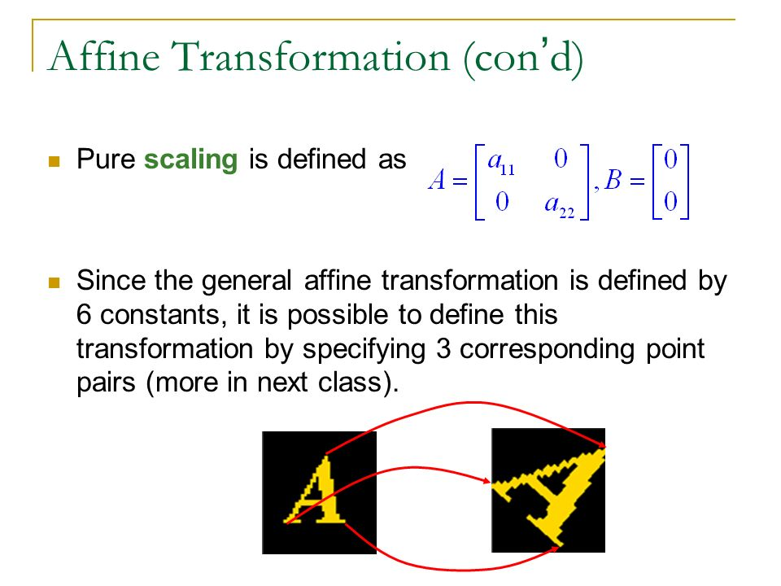

Slide 26
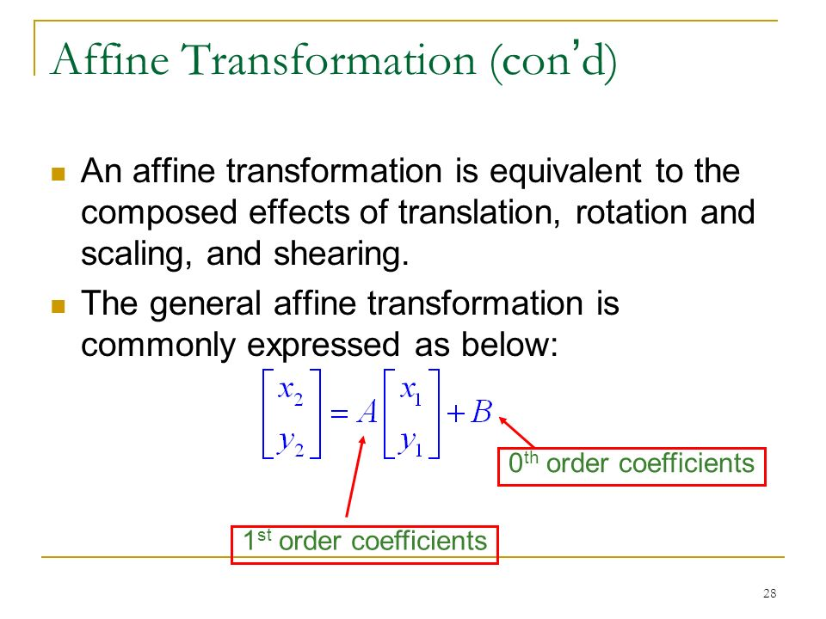

Slide 27
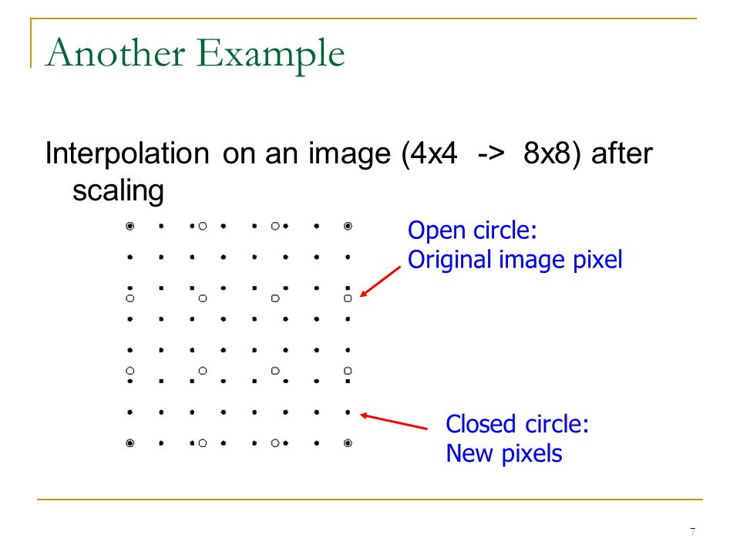

Slide 28
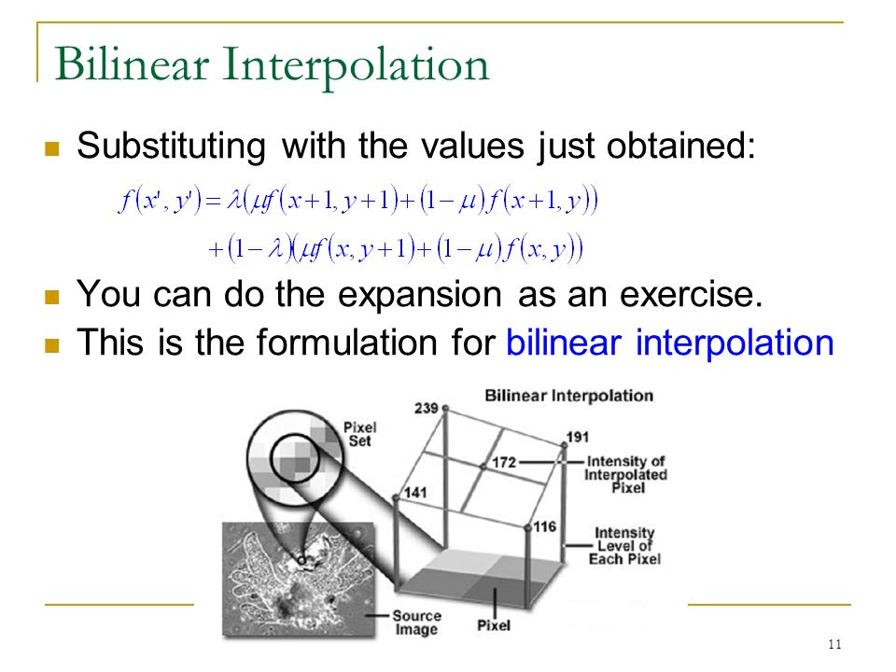

Slide 29
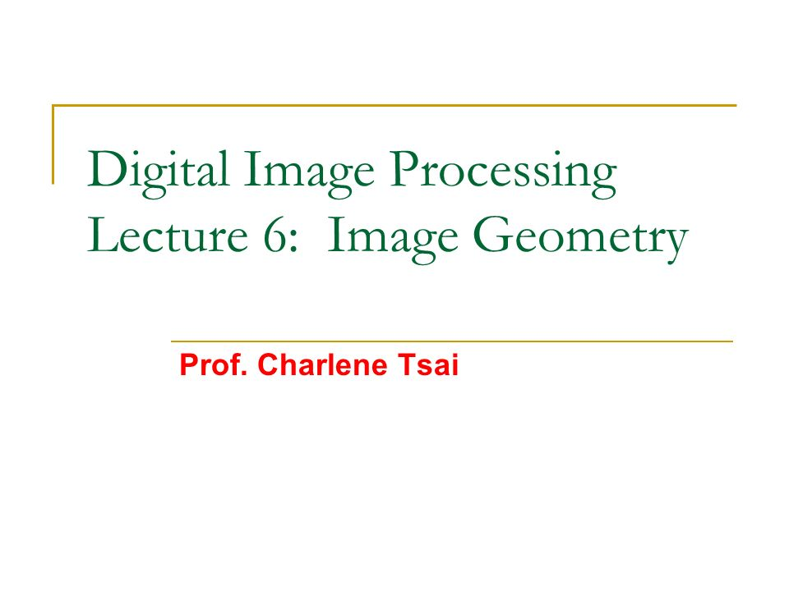

Slide 30
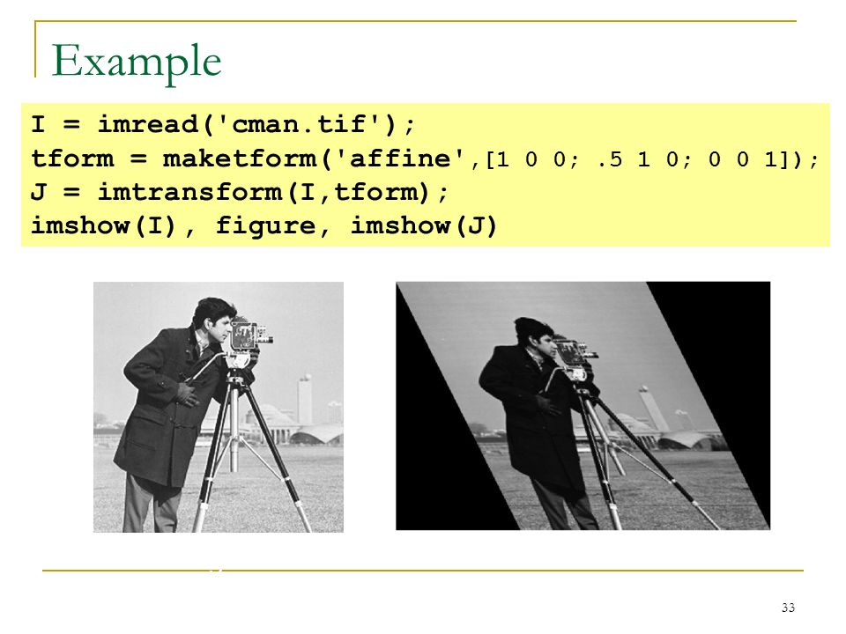

Slide 31
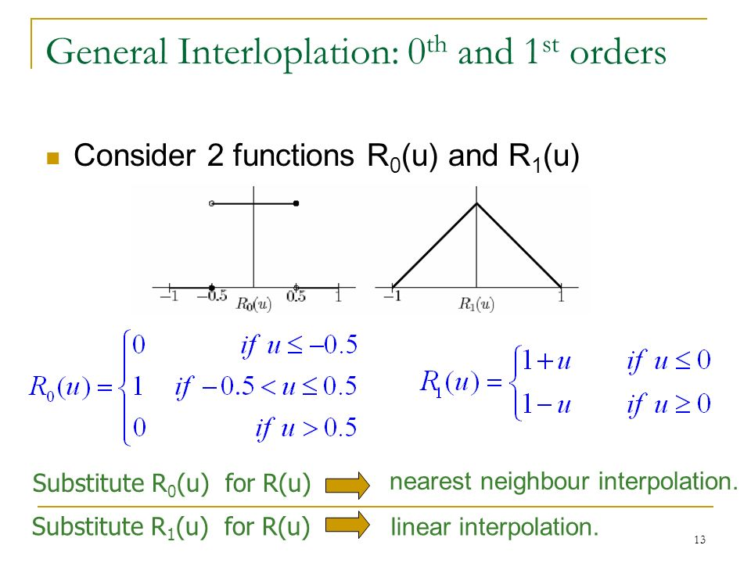

Slide 32
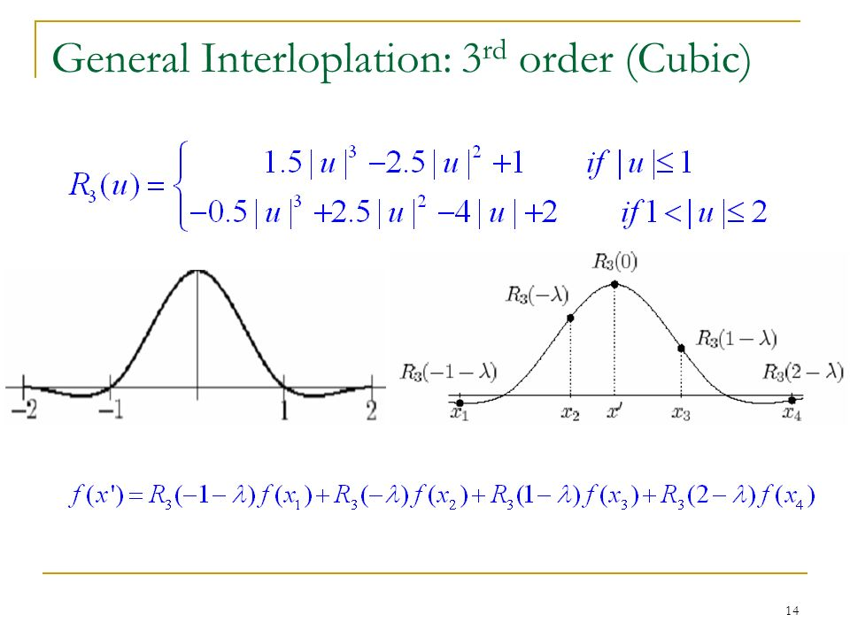

Slide 33
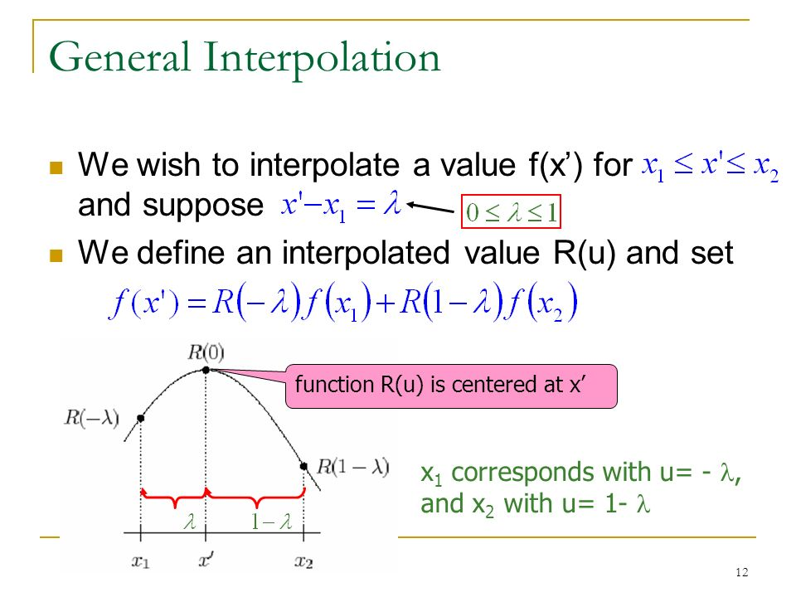

Slide 34
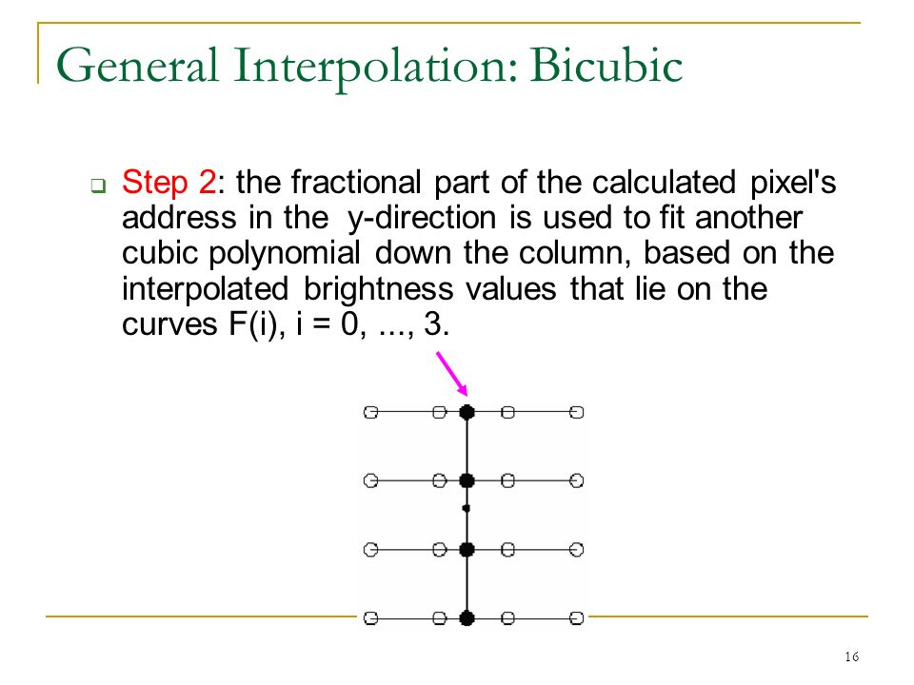

Slide 35
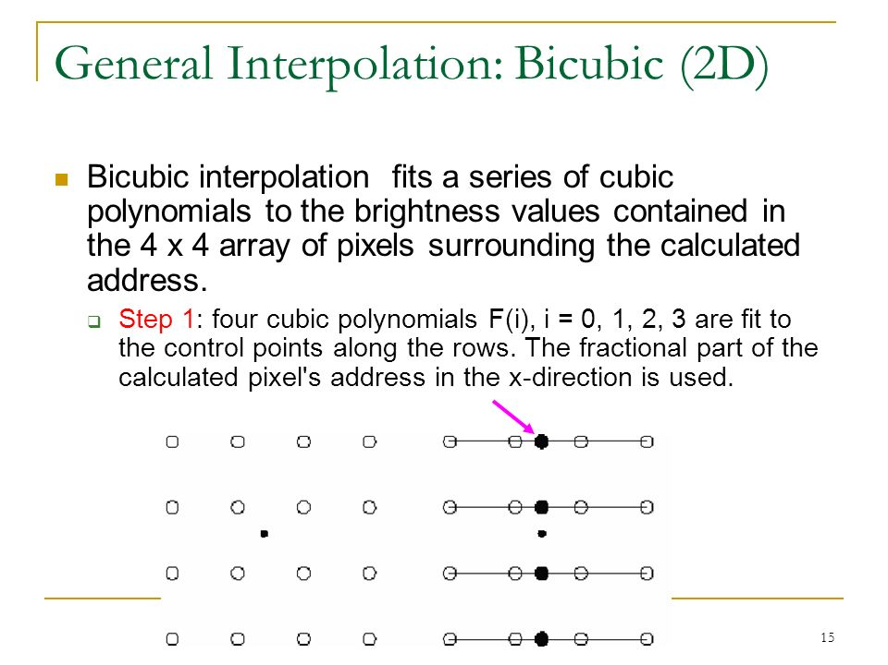

Slide 36
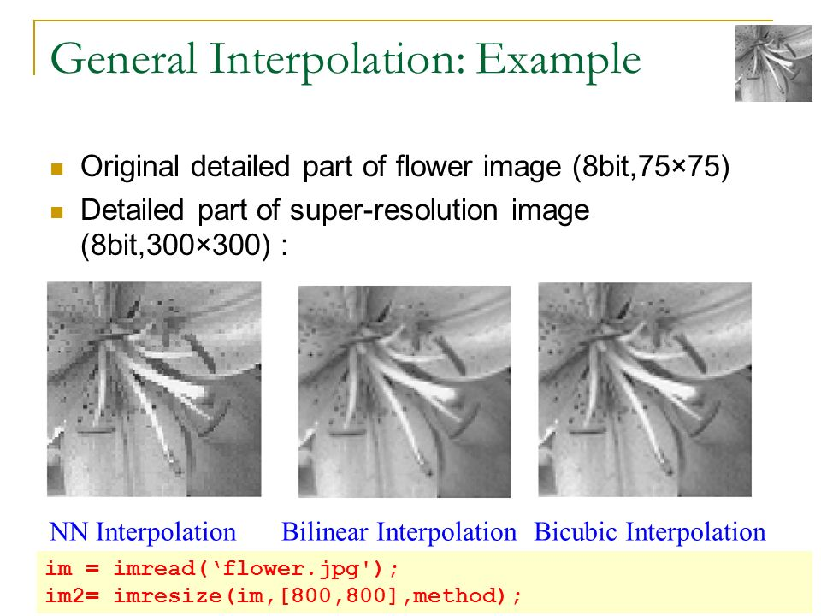

Slide 37
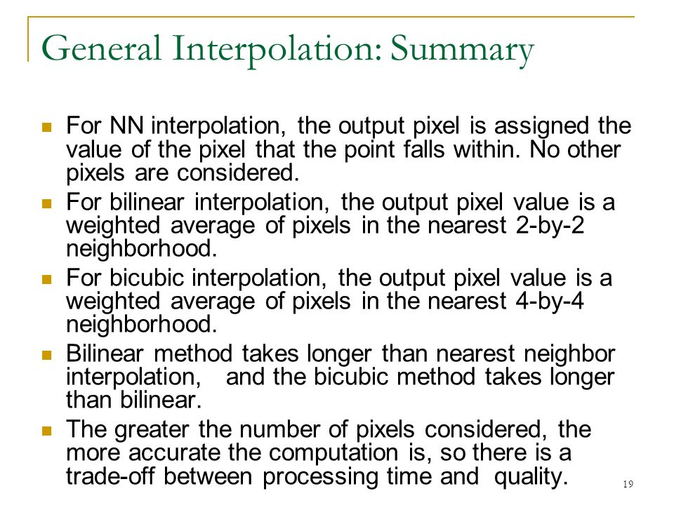

Slide 38
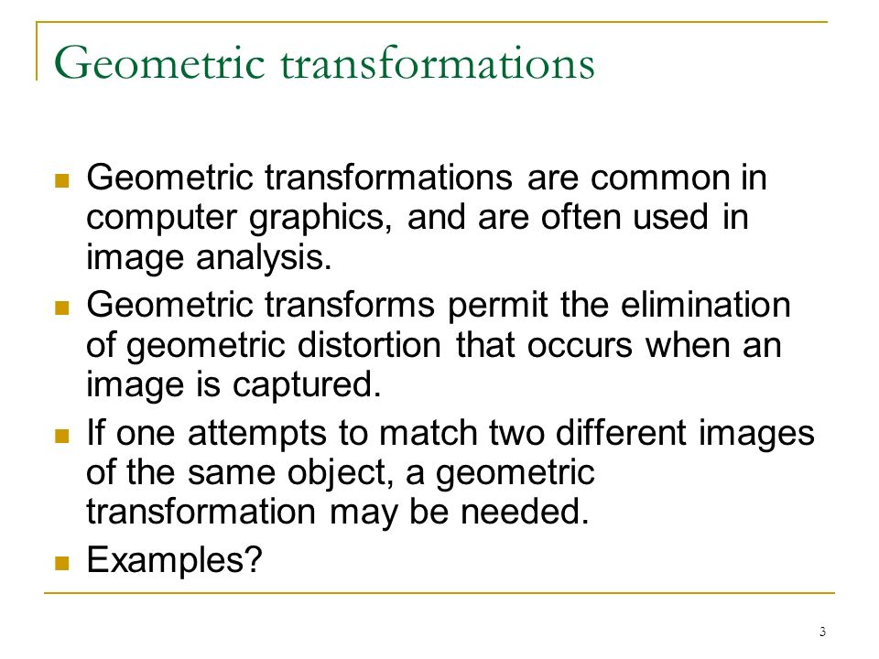

Slide 39
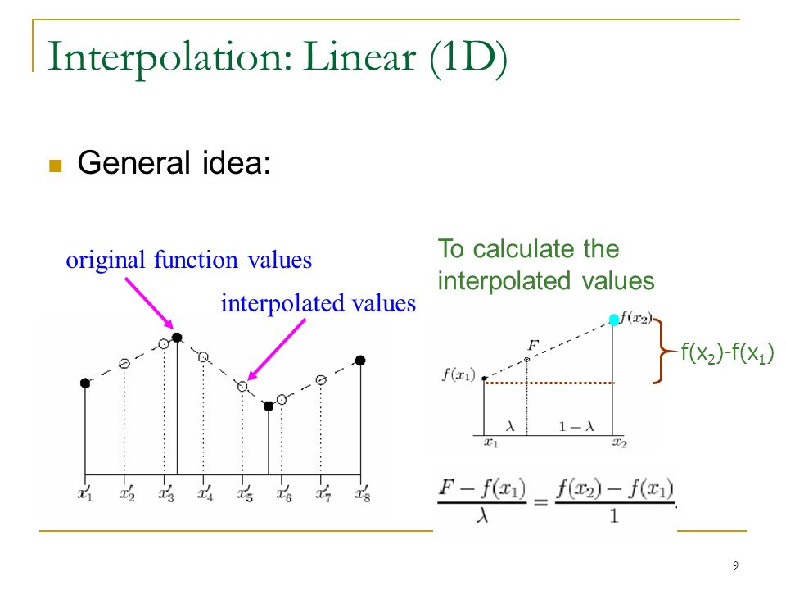

Slide 40
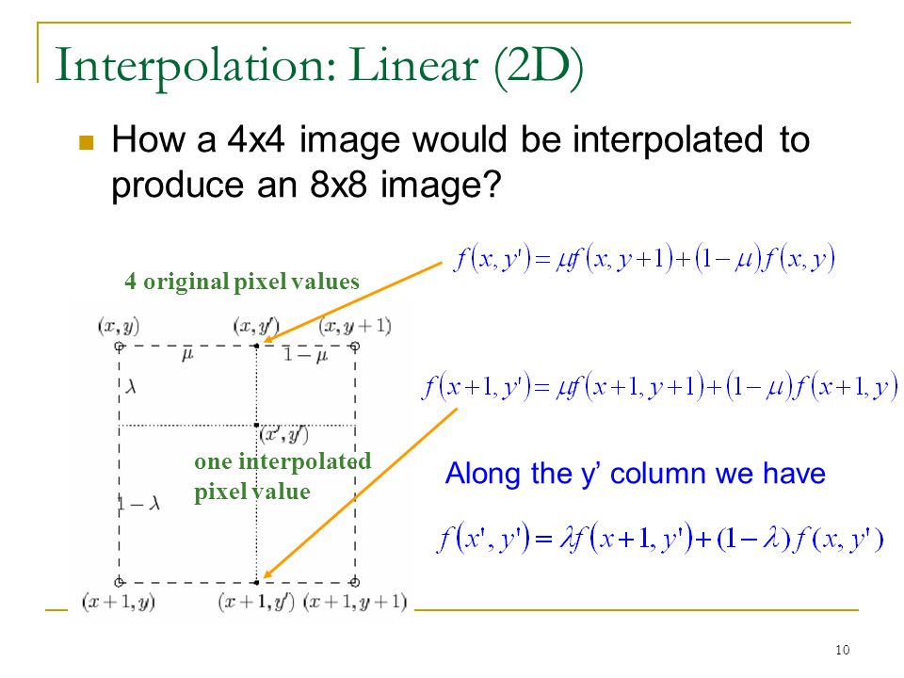

Slide 41
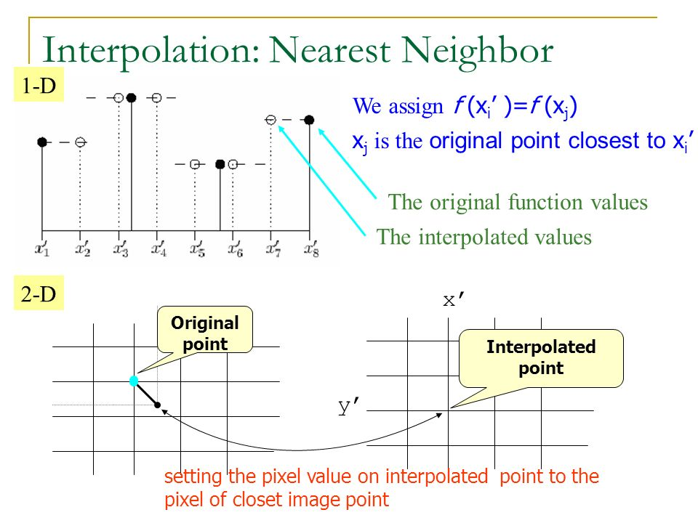

Slide 42
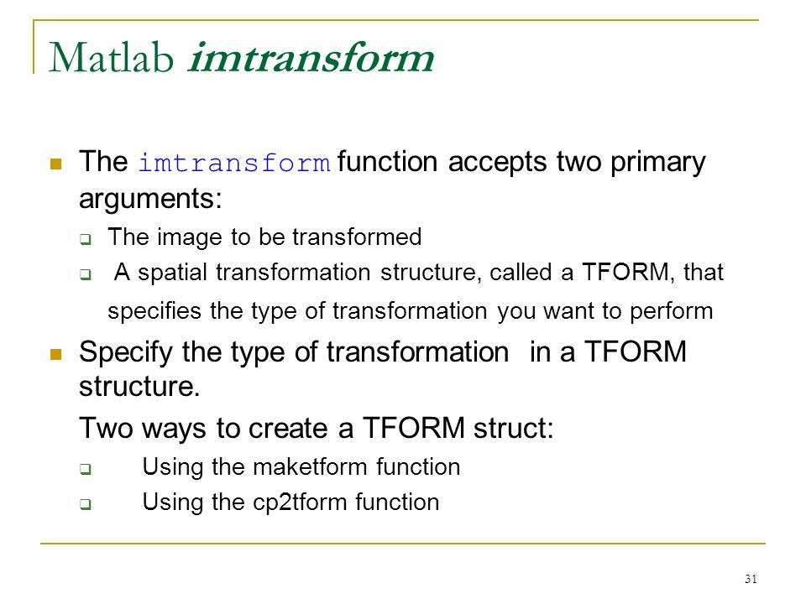

Slide 43
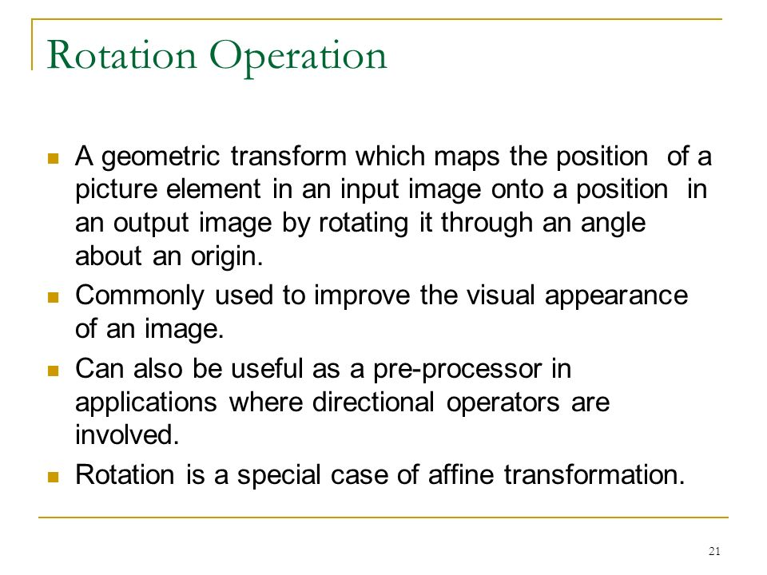

Slide 44
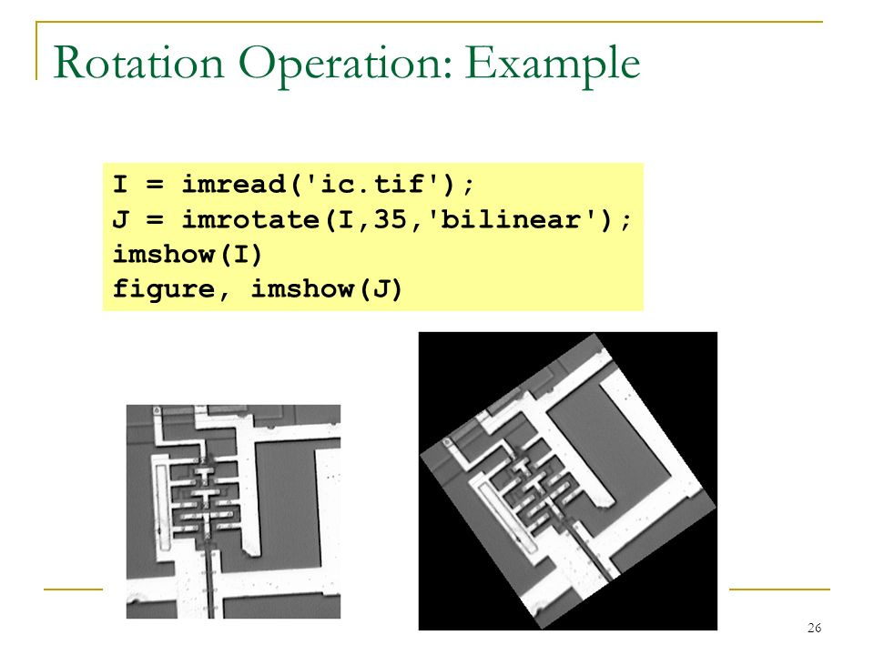

Slide 45
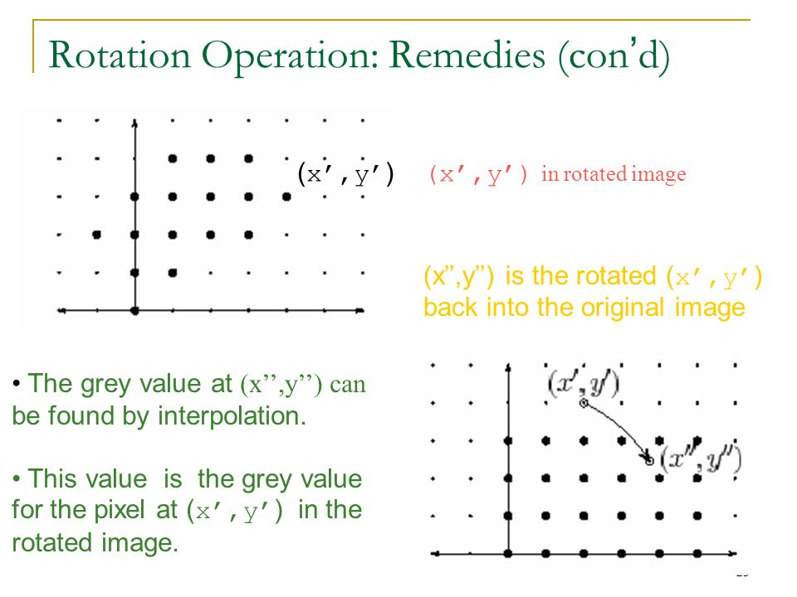

Slide 46
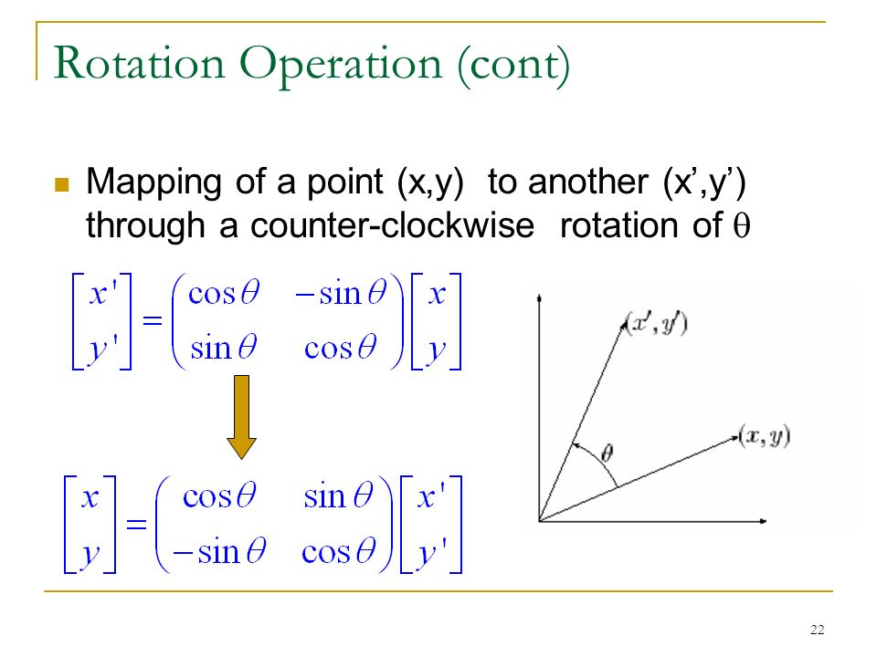

Slide 47
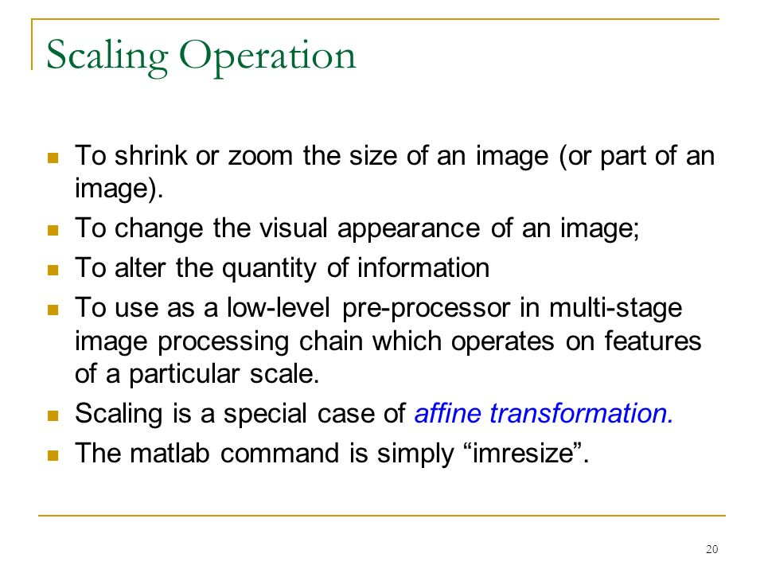

Slide 48
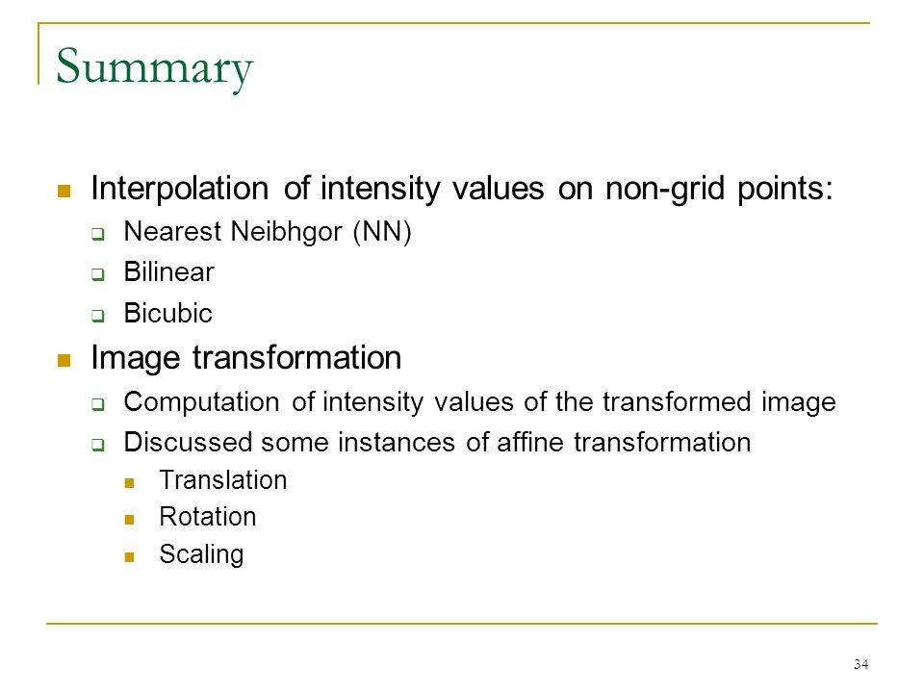

Slide 49
